Slide 1

Social Security Schemes
As fall back support system

Slide 2
Schemes to support social security
Wage Employment (MGNREGS)- 100 Days wage employment guaranteed
Health Insurance (PM Jan Arogya Yojana- Ayushman Bharat)- Rs 5 lakh health insurance coverage per family
Life Insurance (PM Jeevan Jyoti Bima Yojana, PM Suraksha Bima Yojana)- Benefits of Rs 2 lakh per person in case of death
Crop Insurance (PM Fasal Bima Yojana)-Provide insurance coverage and financial support to the farmers in the event of failure of any of the notified crops as a result of natural calamities, pests & diseases
Pension Schemes (Atal Pension Yojana, NSAP)- Pension scheme focused on providing social security to unorganized sector workers Guaranteed minimum pension ranging between ₹1000 to ₹5000 per month depending upon the contribution of subscribers
INCLUDE STATE SPECIFIC SCHEMES ALSO

Slide 3

Wage Employment
Guarantee Scheme
MGNREGS

Slide 4
MGNREGS
Benefits
Entitled to work for 100 days per household per year
Wage rate differs from state to state
Eligibility: Any person above age of 18, residing in rural area and volunteer to do unskilled work
Entitled to receive work within 15 days of demanding work
If work is not provided within 15 days, applicant entitled to unemployment allowance (1/3 wage rate for first 30 days and half the wage after 30 days)
Work to be provided within a radius of 5 km of applicant’s residence (Travel allowance must be paid if more than 5km)
Whom to approach : Job card application from Panchayat office. An individual may appear personally before the Panchayat Secretary or Gram Rozgar Sahayak and make an oral request for registration.

Slide 5


HEALTH
INSURANCE

Slide 6
Pradhan Mantri Jan Arogya Yojana- Ayushman Bharat
It is a paperless and cashless health insurance scheme that aims at providing a health cover of ₹5 lakh per family per year as per SECC 2011
It covers cost of medication, hospitalization, 3 days of pre hospitalization and 15 days of post-hospitalization expenses. It also covers for secondary and tertiary hospitalization expenses
Beneficiary can visit any empanelled public or private hospital to avail cashless treatment
There is no cap on the family size or age of members
All pre-existing diseases are covered from very first day
Apply through official website: https://www.pmjay.gov.in/

Slide 7
Benefits under PM-JAY
Medical examination, treatment and consultation
Pre-hospitalization
Medicine and medical consumables
Non-intensive and intensive care services
Diagnostic and laboratory investigations
Medical implantation services (where necessary)
Accommodation benefits
Food services
Complications arising during treatment
Post-hospitalization follow-up care up to 15 days

Slide 8
Eligibility
Rural Households
Households with only one room, kutcha walls and kutcha roof
Family which has No adult member between 16-59 years
Family which has No adult male member between 16-59 years
Disabled member and no able-bodied adult member
SC/ST households
Landless households deriving major part of their income from manual casual labour
Manual scavenger households
Primitive tribal group, legally released bonded labour

Slide 9


LIFE INSURANCE

Slide 10
HUMAN INSURANCE

Slide 11
Pradhan Mantri Jeevan Jyoti Bima Yojana (PMJJBY)
Life insurance cover for death due to any reason
It is a one year cover, renewable year to year
Scheme offered through LIC and other life insurance companies
Annual premium of ₹436 is payable which will be auto-debited in one installment from holders account
₹2 lakh is payable on members death due to any cause
Insurance cover shall not be available for death (other than due to accident) occurring during first 30 days from date of enrolment
Eligibility: All individual account holders of participating banks/Post office in age group of 18-50 years
How to apply: Approach your nearest branch with Aadhar card

Slide 12
Pradhan Mantri Suraksha Bima Yojana
Offers life insurance cover for protection against death or disability due to an accident
It is a one year cover, renewable year to year
Annual premium of ₹20 is payable which will be auto-debited from holders account
₹2 lakh payable on members death due to an accident and ₹1 lakh on partial disability
Eligibility: All individual account holders of participating banks/ post office in the age group of 18-70 years
How to apply: Approach your nearest branch with Aadhar card

Slide 13
LIVESTOCK INSURANCE

Slide 14
Livestock insurance scheme
5 animals per beneficiary per household for all animals except sheep, goat, pig and rabbit. In case of sheep, goat, pig and rabbit the benefit of subsidy is to be restricted 50 animals.
coverage of the scheme is entire country since 21st May, 2014.
75% subsidy on preminum for insurance of animals

Slide 15

CROP INSURANCE

Slide 16
Pradhan Mantri Fasal Bima Yojana
Provide insurance coverage and financial support to the farmers in the event of failure of any of the notified crops as a result of natural calamities, pests & diseases
To stabilize the income of farmers to ensure their continuance in farming.
To encourage farmers to adopt innovative and modern agricultural practices.
To ensure the flow of credit to the agriculture sector
How to apply: https://pmfby.gov.in/

Slide 17

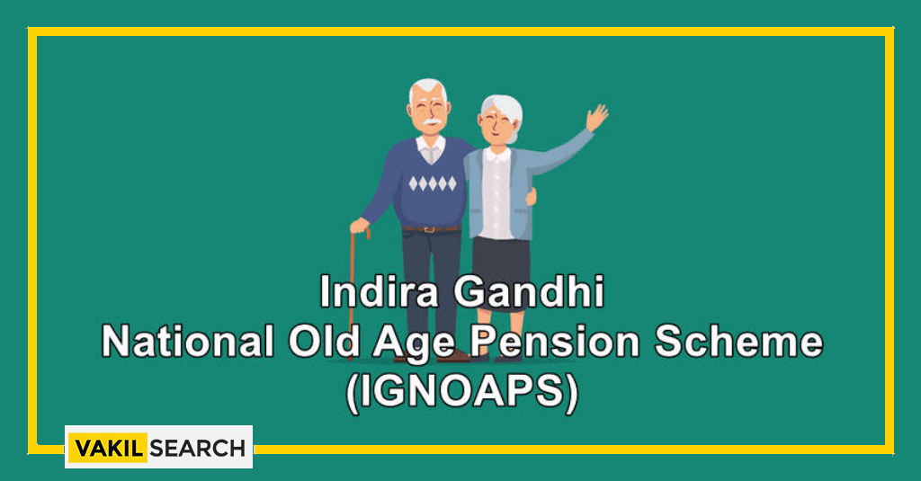

PENSION SCHEMES
Indira Gandhi Widow Pension Scheme

Slide 18
Atal Pension Yojana
Pension scheme focused on providing social security to unorganized sector workers
Guaranteed minimum pension ranging between ₹1000 to ₹5000 per month depending upon the contribution of subscribers
The exit is permitted at the age of 60. In case of death of subscriber the pension will be available to spouse and on the death of both of them the pension corpus would be returned to nominee
Eligibility: Subscriber should be between 18-40 years and should have a savings account in bank or post office
Non income tax payee
How to apply: Approach your nearest bank branch

Slide 19
National Social Assistance Programme (NSAP)
Indira Gandhi National Old Age Pension Scheme
GoI provides financial assistance of ₹200/month (between 60-79 years) and ₹500/month (80 years and above). State govts also contribute to this financial assistance.
Eligibility: Applicant should be minimum 60 years old, belong to BPL and not receiving any other social welfare pensions
Whom to approach: Gram panchayat office
Indira Gandhi National Widow Pension Scheme
GoI provides financial assistance of ₹200/month
Eligibility: Widow in age group of 40-59 years from BPL household
Whom to approach: Gram panchayat office

Slide 20
Indira Gandhi National Disability Pension Scheme
A pension of Rs.300/- per month is provided to Divyangjan between 18 years and 79 years. For persons who are 80 years and above the pension of Rs.500/- per month will be provided.
Dwarfs will also be an eligible category
Eligibility: Applicant must be between 18-79 years with severe or multiple disabilities( 80% or above) and belonging to BPL household
How to apply: Download UMANG App or visit https://web.umang.gov.in/web_new/home

Slide 21

Any Questions?

Slide 22


